Slide 1
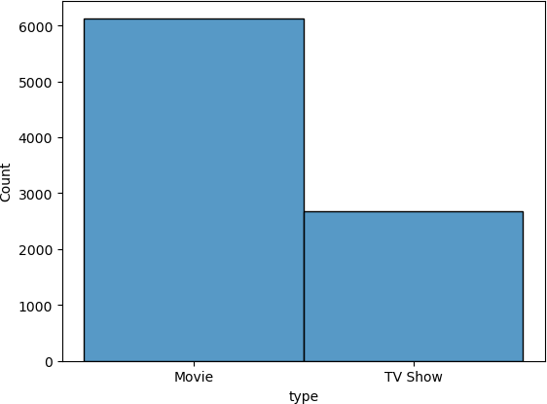
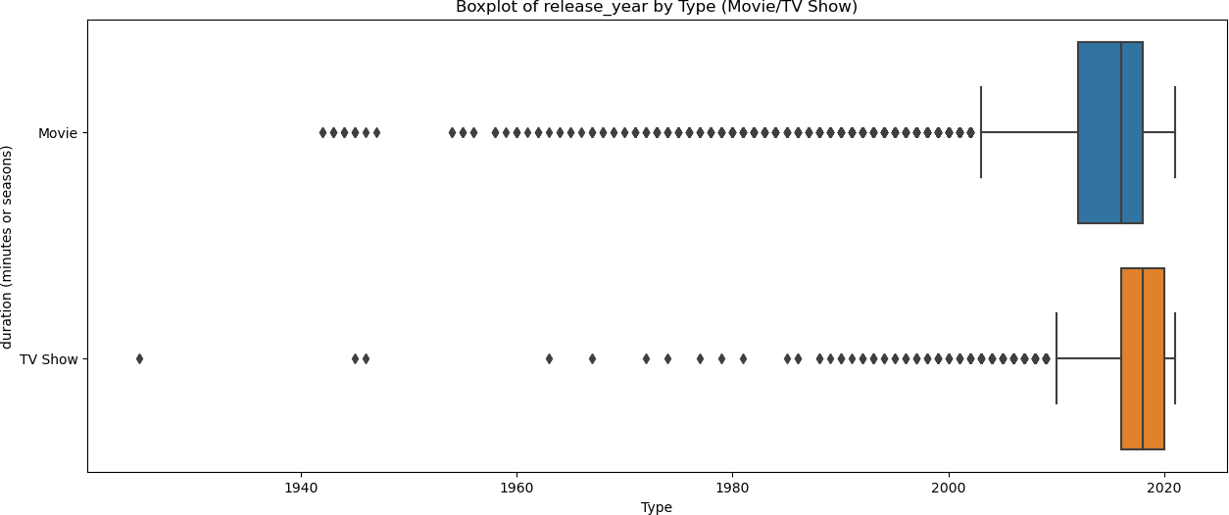
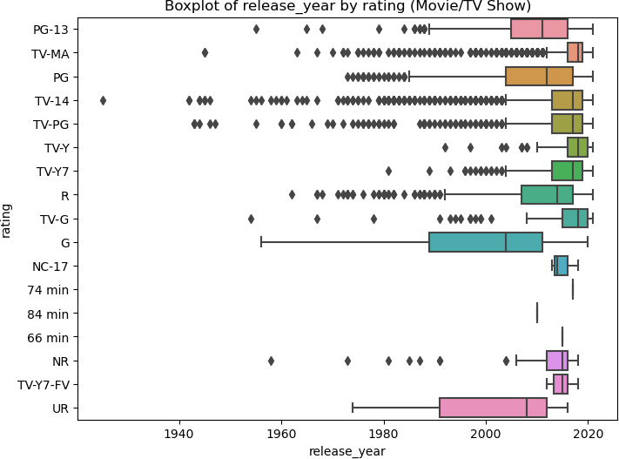
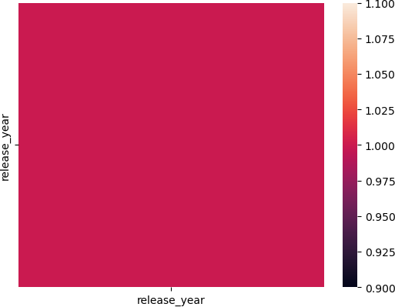
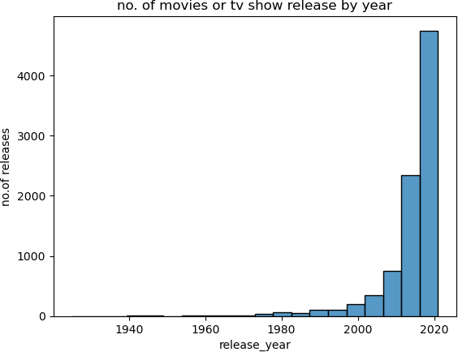
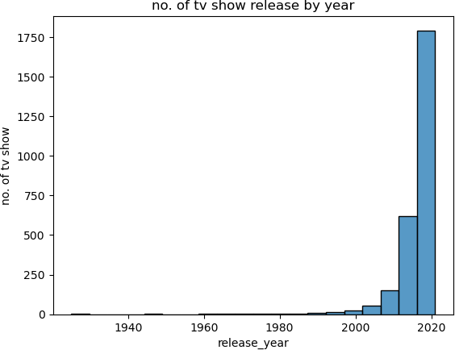
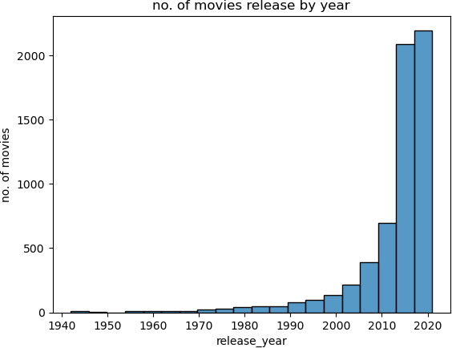
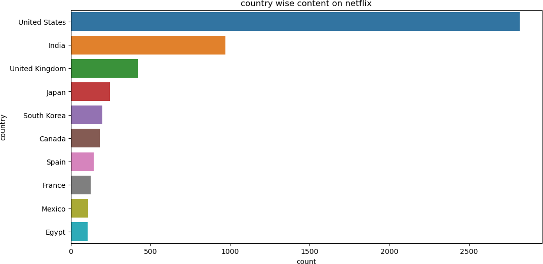
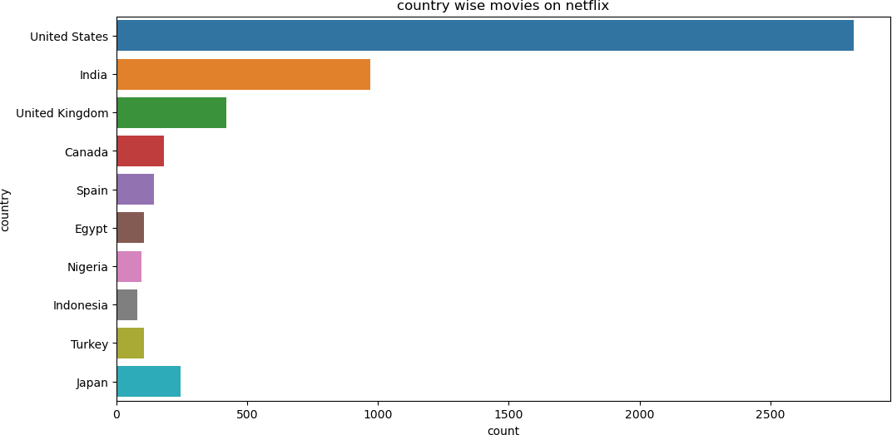
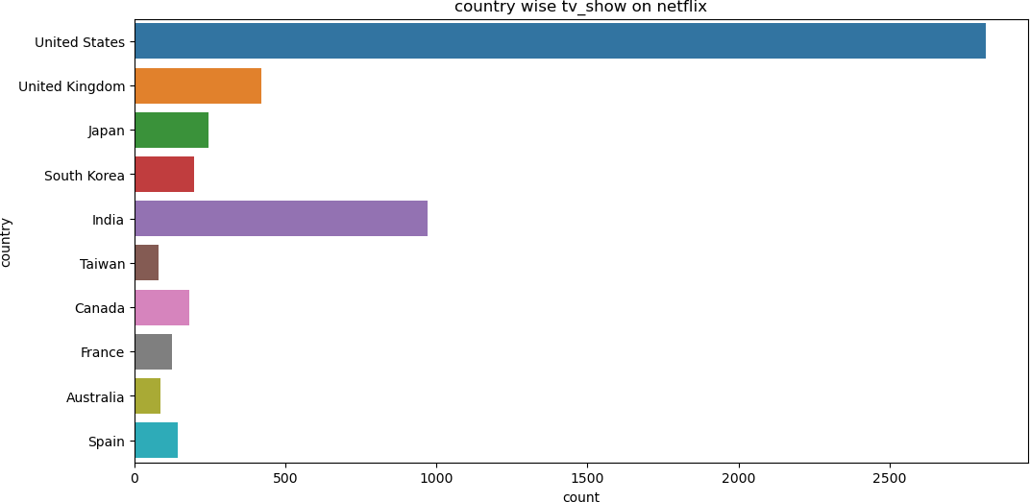
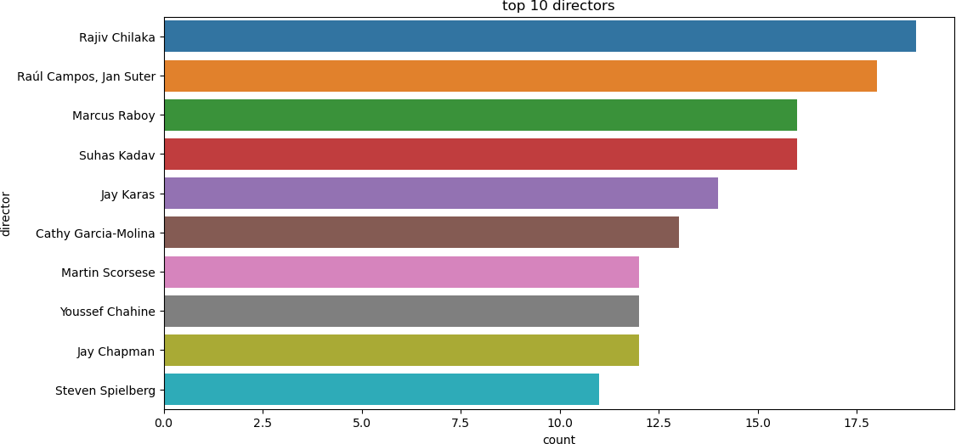
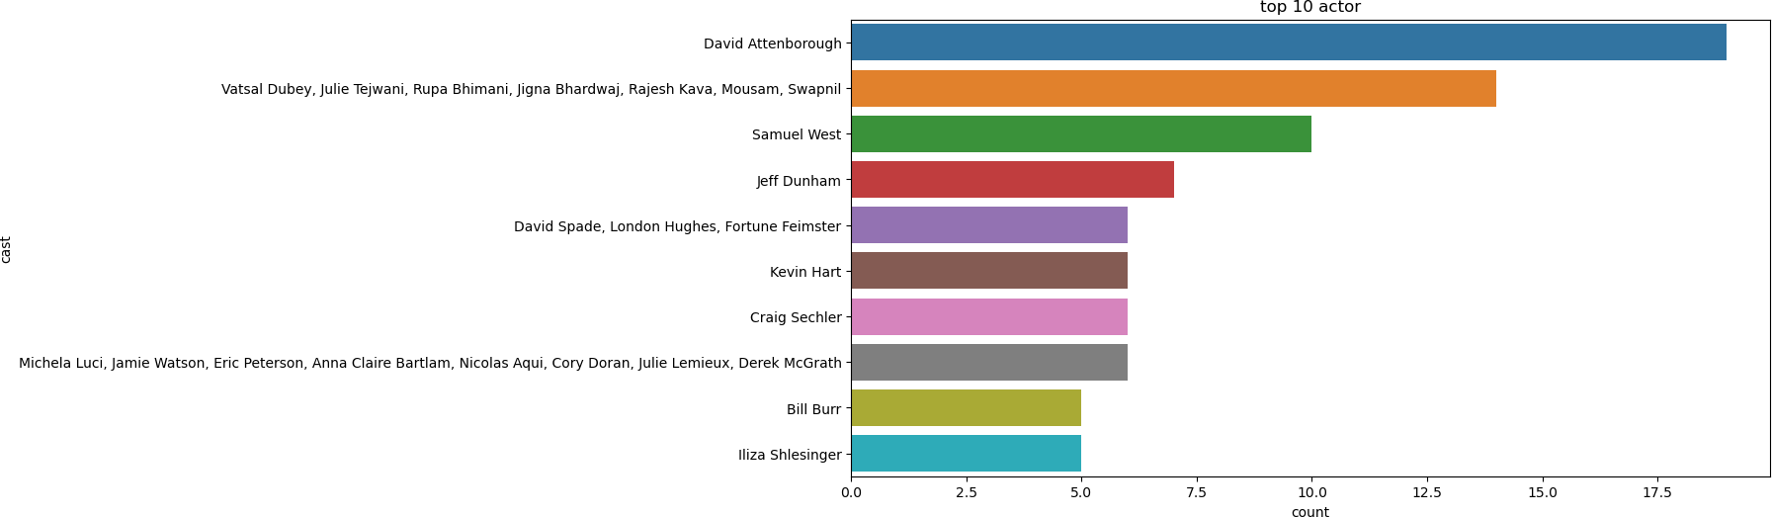
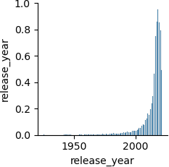
In [12]:
Business Case: Netflix - Data Exploration and Visualisation
import pandas as pd
import numpy as np
import matplotlib.pyplot as plt
import seaborn as sns
problem statement
Problem Statement: Netflix, one of the most popular media and video streaming platforms, aims to optimize its content production and grow its business in different countries. To achieve this, they need data-driven insights to guide their decisions on which type of shows/movies to produce and how to strategically expand their content offerings. The company is seeking to understand the current landscape of content available in different countries, analyze trends in the number of movies released over the last 20-30 years, compare TV shows vs. movies, identify the best time to launch TV shows, and assess the focus on TV shows compared to movies in recent years. Netflix also wants to gain insights into the actors and directors associated with different types of shows/movies and the availability of content in various genres. The analysis should be presented in a clear, understandable manner, as the target audience for the findings are business executives with basic data science knowledge. The goal is to provide actionable recommendations backed by data to help Netflix make
informed decisions that can lead to business growth and audience engagement.
In [13]: #load the dataset
df=pd.read_csv('netflix.csv')
In [14]: # first few row of dataset
df.head()
Out[14]: show_id type title director cast country date_added release_year rating duration listed_in description
0 s1 Movie ^{Dick Johnson Kirsten} NaN ^{United September 25,} 2020 ^{PG-} 90 min Documentaries ^{As her father nears the} Is Dead Johnson States 2021 13 end of his life, filmm...
TV ^{Ama Qamata, Khosi} South September 24, TV- 2 International TV Shows, TV After crossing paths at a
^{1 s2} Show Blood & Water NaN Ngema, Gail Mabalane, Africa 2021 ²⁰²¹ MA Seasons Dramas, TV Mysteries party, a Cape Town t...
Thaban...
TV Julien ^{Sami Bouajila, Tracy} September 24, TV- ^{Crime TV Shows,} To protect his family from
^{2 s3} Show ^{Ganglands} Leclercq Gotoas, Samuel Jouy, NaN 2021 ²⁰²¹ MA 1 Season International TV Shows, TV a powerful drug lor...
Nabi...
Act...
3 s4 ^{TV Jailbirds New} NaN NaN NaN ^{September 24,} 2021 ^{TV-} 1 Season Docuseries, Reality TV ^{Feuds, flirtations and} Show Orleans 2021 MA toilet talk go down amo...
TV ^{Mayur More, Jitendra} September 24, TV- 2 International TV Shows, In a city of coaching
^{4 s5} Show Kota Factory NaN Kumar, Ranjan Raj, Alam India 2021 ²⁰²¹ MA Seasons Romantic TV Shows, TV ... centers known to train I...
K...
In [15]: # last few row of dataset
df.tail()
Out[15]: show_id type title director cast country date_added release_year rating duration listed_in description
David ^{Mark Ruffalo, Jake} United November 20, Cult Movies, Dramas, A political cartoonist, a
8802 s8803 Movie Zodiac Fincher ^{Gyllenhaal, Robert Downey} States 2019 ^{2007 R 158 min} Thrillers crime reporter and a...
J...
8803 s8804 ^{TV Zombie} NaN NaN NaN July 1, 2019 2018 TV-Y7 2 Kids' TV, Korean TV While living alone in a Show Dumb Seasons Shows, TV Comedies spooky town, a young g...
8804 s8805 Movie Zombieland Ruben Jesse Eisenberg, Woody United November 1, 2009 R 88 min Comedies, Horror Movies ^{Looking to survive in a} Fleischer Harrelson, Emma Stone, ... States 2019 world taken over by zo...
8805 s8806 Movie Zoom Peter Tim Allen, Courteney Cox, United January 11, 2006 PG 88 min Children & Family Movies, Dragged from civilian life, Hewitt Chevy Chase, Kate Ma... States 2020 Comedies a former superhero...
8806 s8807 Movie Zubaan Mozez Vicky Kaushal, Sarah-Jane India March 2, 2019 2015 TV-14 111 min Dramas, International A scrappy but poor boy Singh Dias, Raaghav Chanan... Movies, Music & Musicals worms his way into a ty...
In [16]: #total unique rating
df['rating'].nunique()
Out[16]: ¹⁷
In [17]: df['rating'].value_counts()
Out[17]: ^{TV-MA 3207}
TV-14 2160
TV-PG 863
R 799
PG-13 490
TV-Y7 334
TV-Y 307
PG 287
TV-G 220
NR 80
G 41
TV-Y7-FV 6
NC-17 3
UR 3
74 min 1
84 min 1
66 min 1
Name: rating, dtype: int64
In [18]: # to get shape of dataset
df.shape
Out[18]: ^{(8807, 12)}
In [19]: # to get columns of dataset
df.columns
Out[19]: Index(['show_id', 'type', 'title', 'director', 'cast', 'country', 'date_added',
'release_year', 'rating', 'duration', 'listed_in', 'description'], dtype='object')
In [20]: # Shape of dataset
df.shape
Out[20]: ^{(8807, 12)}
In [21]: # datatype of colimns in dataset
df.dtypes
Out[21]: ^{show_id object}
type object
title object
director object
cast object
country object
date_added object
release_year int64
rating object
duration object
listed_in object
description object dtype: object
inspecting missing value
In [22]: m_v=df.isnull().sum().sort_values(ascending=False)
In [23]: m_v
Out[23]: ^{director 2634}
country 831
cast 825
date_added 10
rating duration show_id type
4
3
0
0
title 0
release_year 0
listed_in 0
description 0 dtype: int64
In [26]: # information of the dataset
df.info()
<class 'pandas.core.frame.DataFrame'> RangeIndex: 8807 entries, 0 to 8806 Data columns (total 12 columns):
# Column Non-Null Count Dtype
show_id 8807 non-null object
type 8807 non-null object
title 8807 non-null object
director 6173 non-null object
cast 7982 non-null object
country 7976 non-null object
date_added 8797 non-null object
release_year 8807 non-null int64
rating 8803 non-null object
duration 8804 non-null object
listed_in 8807 non-null object
description 8807 non-null object dtypes: int64(1), object(11)
memory usage: 825.8+ KB
In [27]: # checking missing value in % terms
round(df.isnull().sum()/df.shape[0]*100,2).sort_values(ascending=False)
Out[27]: ^{director 29.91}
country 9.44
cast 9.37
date_added 0.11
rating 0.05
duration 0.03
show_id 0.00
type 0.00
title 0.00
release_year 0.00
listed_in 0.00
description 0.00
dtype: float64
statistical summary
In [29]: df.describe()
Out[29]: release_year count 8807.000000
mean 2014.180198
std 8.819312
min 1925.000000
25% 2013.000000
50% 2017.000000
75% 2019.000000
max 2021.000000
Observation: There are 8807 rows and 12 columns in the dataset.Datatype of all columns is object expect release year which is int. Columns with more null values are “director”,”countrty”,”cast”. 1925 is the minimum release year and 2021
Non-Graphical Analysis: Value counts and unique attributes
In [30]: df[['minutes','unit']]=df['duration'].str.split(" ",expand=True) df.head()
Out[30]: show_id type title director
cast country date_added release_year rating duration listed_in description minutes unit
Dick Johnson Kirsten
United September PG- ^{As her father nears}
^{0 s1 Movie} Is Dead Johnson ^{NaN} States 25, 2021 ²⁰²⁰ 13 90 min Documentaries the end of his life, 90 min
filmm...
TV Blood & ^{Ama Qamata, Khosi} South September TV- 2 International TV Shows, After crossing paths
^{s2} Show Water NaN Ngema, Gail Africa 24, 2021 ²⁰²¹ MA Seasons TV Dramas, TV at a party, a Cape 2 Seasons Mabalane, Thaban... Mysteries Town t...
TV Julien ^{Sami Bouajila, Tracy} September TV- 1 Crime TV Shows, To protect his family
^{s3} Show ^{Ganglands} Leclercq ^{Gotoas, Samuel NaN} 24, 2021 ²⁰²¹ MA Season International TV Shows, from a powerful drug 1 Season Jouy, Nabi... TV Act... lor...
TV Jailbirds New September TV- 1 ^{Feuds, flirtations and}
^{s4} Show Orleans NaN NaN NaN 24, 2021 ²⁰²¹ MA Season Docuseries, Reality TV toilet talk go down 1 Season
amo...
TV ^{Mayur More, Jitendra} September TV- 2 International TV Shows, In a city of coaching
^{4 s5} Show Kota Factory NaN Kumar, Ranjan Raj, India 24, 2021 ²⁰²¹ MA Seasons Romantic TV Shows, centers known to 2 Seasons
Alam K... TV ... train I...
In [31]: # top 10 directors
df['director'].value_counts().head(10)
Out[31]: ^{Rajiv Chilaka 19} Raúl Campos, Jan Suter 18
Marcus Raboy Suhas Kadav
16
16
Jay Karas 14
Cathy Garcia-Molina 13
Martin Scorsese Youssef Chahine Jay Chapman
12
12
12
Steven Spielberg 11 Name: director, dtype: int64
In [32]: #number of director
df['director'].nunique()
Out[32]: ⁴⁵²⁸
In [33]: # year with highest no. of releases
df['release_year'].value_counts().head(10)
Out[33]: ²⁰¹⁸ ¹¹⁴⁷
2017 1032
2019 1030
2020 953
2016 902
2021 592
2015 560
2014 352
2013 288
2012 237
Name: release_year, dtype: int64
In [35]: tv_show=df[df['type']=='TV Show'] In [37]: movie_s=df[df['type']=='Movie']
tv_show gener with highest genre
In [41]: tv_show.listed_in.value_counts().head(10)
Out[41]: ^{Kids' TV}
International TV Shows, TV Dramas
220
121
Crime TV Shows, International TV Shows, TV Dramas 110 Kids' TV, TV Comedies 99
Reality TV 95
International TV Shows, Romantic TV Shows, TV Comedies 94
International TV Shows, Romantic TV Shows, TV Dramas 90
Anime Series, International TV Shows Docuseries
TV Comedies
Name: listed_in, dtype: int64
movies gener with highest genre
88
85
69
In [42]: movie_s.listed_in.value_counts().head(10)
Out[42]: ^{Dramas, International Movies} Documentaries
Stand-Up Comedy
362
359
334
Comedies, Dramas, International Movies 274 Dramas, Independent Movies, International Movies 252 Children & Family Movies 215
Children & Family Movies, Comedies 201
Documentaries, International Movies 186 Dramas, International Movies, Romantic Movies 180 Comedies, International Movies 176
Name: listed_in, dtype: int64
country with highest number of tv show
In [36]: tv_show.country.value_counts().head(10)
Out[36]: ^{United States 760}
United Kingdom 213
Japan 169
South Korea 158
India 79
Taiwan 68
Canada 59
France 49
Australia 48
Spain 48
Name: country, dtype: int64
country with highest number of movies
In [231… movie_s.country.value_counts().head(10) Out[231]: ^{United States 2055}
India 893
unknown 439
United Kingdom 206
Canada 122
Spain 97
Egypt 92
Nigeria 86
Indonesia 77
Turkey 76
Name: country, dtype: int64
movies vs tv show
In [234… df.groupby('type').type.count()
Out[234]: ^{type}
Movie 6131
TV Show 2676
Name: type, dtype: int64
In [233… sns.histplot(df['type']) plt.show()
In [235… # top 10 cuntry with highest content
df['country'].value_counts().head(10)
Out[235]: ^{United States 2818} India 972
United Kingdom 419
Japan 245
South Korea 199
Canada Spain France Mexico
181
145
124
110
Egypt 106
Name: country, dtype: int64
In [236… #latest_movies: last 25 year movie
latest_movies=df[(df['release_year']>=1995) & (df['type']=='Movie')]
In [237… latest_movies['release_year'].value_counts()
Out[237]: ²⁰¹⁷ ⁷⁶⁷
2018 767
2016 658
2019 633
2020 517
2015 398
2021 277
2014 264
2013 225
2012 173
2010 154
2011 145
2009 118
2008 113
2006 82
2007 74
2005 67
2004 55
2003 51
2002 44
2001 40
1997 34
2000 33
1998 32
1999 32
1995 23
1996 21
Name: release_year, dtype: int64
observation: here we see the how the number of movies releaseing over the last 25 year from 1995 to 2021 is changing in 1995 only 23 movie released but in 2021 277 movie released and year 2017 with the highest number of movie release which is 767. there is exponentioal growth in number of movies released so we conclude that after the year passes more movies are released as people are consuming more entertainment content.
In [239… # most listed content
df.listed_in.value_counts().head(10)
Out[239]: ^{Dramas, International Movies} Documentaries
Stand-Up Comedy
362
359
334
Comedies, Dramas, International Movies
274
Dramas, Independent Movies, International Movies 252 Kids' TV 220
Children & Family Movies 215
Children & Family Movies, Comedies 201
Documentaries, International Movies 186 Dramas, International Movies, Romantic Movies 180 Name: listed_in, dtype: int64
In [240… # least listed content
df.listed_in.value_counts().tail(10)
1
Out[240]: Docuseries, Reality TV, Teen TV Shows
Crime TV Shows, International TV Shows, Reality TV 1 Anime Features, Romantic Movies 1
Anime Features, Music & Musicals 1
British TV Shows, Kids' TV, TV Thrillers 1
Kids' TV, TV Action & Adventure, TV Dramas 1
In [241…
TV Comedies, TV Dramas, TV Horror 1 Children & Family Movies, Comedies, LGBTQ Movies 1 Kids' TV, Spanish-Language TV Shows, Teen TV Shows 1 Cult Movies, Dramas, Thrillers 1 Name: listed_in, dtype: int64
#adding one new column of datatype date and type df['date_n']=pd.to_datetime(df["date_added"]) df.head(2)
Out[241]: show_id type title director cast country date_added release_year rating duration listed_in description minutes unit date_n
^{Dick} Kirsten United September PG- ^{As her father}
2021-
0 s1 Movie Johnson Is Johnson Dead
^{NaN} States 25, 2021 ²⁰²⁰ 13 90 min Documentaries nears the end of 90 min 09-25
his life, filmm...
^{Ama Qamata,} International TV After crossing
1 s2 ^{TV Blood &} NaN Khosi Ngema, Gail South September 2021 ^{TV- 2} Shows, TV Dramas, paths at a party, a 2 Seasons ²⁰²¹⁻
Show Water Mabalane, Africa 24, 2021 MA Seasons TV Mysteries Cape Town t...
Thaban...
09-24
In [242… tv_show=data[data['type']=="TV Show"]
In [243… tv_show.head()
Out[243]: show_id type title director cast country date_added release_year rating duration listed_in description minutes unit date_n
^{Ama Qamata, International TV} After crossing
1 s2 ^{TV Blood &} NaN Khosi Ngema, Gail South September 2021 TV- 2 Shows, TV paths at a party, a 2 Seasons ²⁰²¹⁻
Show Water Mabalane, Africa 24, 2021 MA Seasons Dramas, TV
Thaban... ^{Cape Town t...}
09-24
Mysteries
^{Sami Bouajila,} Crime TV Shows, To protect his
2 s3 ^{TV} Ganglands ^{Julien Tracy Gotoas,} NaN ^{September} 2021 ^{TV- 1} International TV family from a 1 Season ²⁰²¹⁻
Show Leclercq Samuel Jouy, 24, 2021 MA Season 09-24 Nabi... Shows, TV Act... powerful drug lor...
TV Jailbirds September TV- 1 Docuseries, Reality ^{Feuds, flirtations} 2021-
^{s4} Show New Orleans NaN NaN NaN 24, 2021 ²⁰²¹ MA Season TV and toilet talk go 1 Season 09-24
down amo...
^{Mayur More,} International TV In a city of
s5 ^{TV} Kota Factory NaN ^{Jitendra Kumar,} India ^{September} 2021 ^{TV- 2} Shows, Romantic coaching centers 2 Seasons 2021- Show Ranjan Raj, Alam 24, 2021 MA Seasons TV Shows, TV ... known to train I... ⁰⁹⁻²⁴
K...
TV Midnight Mike ^{Kate Siegel, Zach} September TV- 1 TV Dramas, TV The arrival of a 2021-
^{s6} Show Mass Flanagan ^{Gilford, Hamish NaN} 24, 2021 ²⁰²¹ MA Season Horror, TV charismatic young 1 Season 09-24 Linklater, H... Mysteries priest brin...
In [244… movie_s=df[df['type']=='Movie'] movie_s.head(2)
Out[244]: show_id type title director
cast country date_added release_year rating duration listed_in description minutes unit date_n
Dick Johnson Is Kirsten
United September PG- ^{As her father nears}
2021-
^{0 s1 Movie} Dead Johnson ^{NaN} States 25, 2021 ²⁰²⁰ 13 90 min Documentaries the end of his life, 90 min 09-25
filmm...
My Little Pony: Robert Vanessa Hudgens, September Children & ^{Equestria's divided.} 2021-
6 s7 Movie A New Cullen, José Kimiko Glenn, NaN 24, 2021 ^{2021 PG 91 min} Family Movies But a bright-eyed 91 min 09-24 Generation Luis Ucha James Marsden, ...
In [245… # year with highest no. of tv_show added
tv_show['date_n'].dt.year.value_counts()
Out[245]: ^{2020.0 595}
hero be...
2019.0 592
2021.0 505
2018.0 412
2017.0 349
2016.0 176
2015.0 26
2014.0 5
2013.0 5
2008.0 1
Name: date_n, dtype: int64
In [246… # month with hihest no. of tv_show added
tv_show['date_n'].dt.month.value_counts()
Out[246]: ^{12.0 266}
7.0 262
9.0 251
8.0 236
6.0 236
10.0 215
4.0 214
3.0 213
11.0 207
5.0 193
1.0 192
2.0 181
Name: date_n, dtype: int64
observation: december month is the best time to launch tv show .
In [247… # count of tv show in recent years
len(tv_show[(tv_show['release_year']>2015)])
Out[247]: ²⁰³⁷
In [248… # count of tv show in recent years
len(movie_s[(movie_s['release_year']>2015)])
Out[248]: ³⁶¹⁹
observation: the number of movies in the recent years i.e years after 2015 surpass the number of tv show .
In [249…
visual analysis
#unnesting the columns cast=data['cast'].str.split(" ", expand=True) cast.head(2)
Out[249]: 0 1 2 3 4 5 6 7 8 9 ... 96 97 98 99 100 101 102 103 104 105
NaN NaN NaN NaN NaN NaN NaN NaN NaN NaN ... NaN NaN NaN NaN NaN NaN NaN NaN NaN NaN
Ama Qamata, Khosi Ngema, Gail Mabalane, Thabang Molaba, Dillon Windvogel, ... None None None None None None None None None None
rows × 106 columns
In [250… country=df['cast'].str.split(" ",expand=True) country.head(2)
Out[250]: 0 1 2 3 4 5 6 7 8 9 ... 96 97 98 99 100 101 102 103 104 105
NaN NaN NaN NaN NaN NaN NaN NaN NaN NaN ... NaN NaN NaN NaN NaN NaN NaN NaN NaN NaN
Ama Qamata, Khosi Ngema, Gail Mabalane, Thabang Molaba, Dillon Windvogel, ... None None None None None None None None None None
rows × 106 columns
In [251… director=data['director'].str.split(" ",expand=True) director.head(2)
Out[251]: 0 1 2 3 4 5 6 7 8 9 ... 19 20 21 22 23 24 25 26 27 28
Kirsten Johnson None None None None None None None None ... None None None None None None None None None None
NaN NaN NaN NaN NaN NaN NaN NaN NaN NaN ... NaN NaN NaN NaN NaN NaN NaN NaN NaN NaN
rows × 29 columns
In [252…
# extracting continuous variable cont=data.select_dtypes("object") cont.head(2)
Out[252]: show_id type title director cast country date_added rating duration listed_in description minutes unit
^{Dick} Kirsten United September 25, PG- As her father nears the
0 s1 Movie Johnson Is Johnson ^{NaN} States 2021 13 90 min Documentaries end of his life, filmm... ^{90 min}
Dead
TV Blood & ^{Ama Qamata, Khosi} South September 24, TV- 2 International TV Shows, TV After crossing paths at a
^{1 s2} Show Water NaN Ngema, Gail Mabalane, Africa 2021 MA Seasons Dramas, TV Mysteries party, a Cape Town t... ^{2 Seasons}
Thaban...
In [254…
#extracting categorical variable categ=df.select_dtypes("number") categ.head(2)
Out[254]: release_year 0 2020
1 2021
In [5]:
box_plot
plt.figure(figsize=(15, 6)) sns.boxplot(x='release_year', y='type', data=df)
plt.title('Boxplot of release_year by Type (Movie/TV Show)')
plt.xlabel('Type')
plt.ylabel('duration (minutes or seasons)') plt.show()
In [6]:
plt.figure(figsize=(8, 6)) sns.boxplot(x='release_year', y='rating', data=df)
plt.title('Boxplot of release_year by rating (Movie/TV Show)') plt.xlabel('release_year')
plt.ylabel('rating')
plt.show()
corealtion
In [9]: a=df.corr()
In [11]: sns.heatmap(a) plt.show()
In [255…
As per the given dataset no corelation is present because one numeric varible has been given.so the corelatio is always 1 and for corelation minimum two numeric variable has to be present in the dataset.
year with highest release
sns.histplot(df['release_year'],bins=20) plt.title("no. of movies or tv show release by year") plt.xlabel("release_year")
plt.ylabel("no.of releases") plt.show()
In [256…
year with highest tv_show release
sns.histplot(tv_show['release_year'],bins=20) plt.title("no. of tv show release by year") plt.xlabel("release_year")
plt.ylabel("no. of tv show") plt.show()
In [257…
year with highest no. of movies release
sns.histplot(movie_s['release_year'],bins=20) plt.title("no. of movies release by year") plt.xlabel("release_year")
plt.ylabel("no. of movies")
plt.show()
In [ ]:
In [258…
plt.figure(figsize=(12,6)) sns.countplot(y='country',order=df['country'].value_counts().index[0:10],data=df) plt.title("country wise content on netflix")
plt.show()
In [272…
plt.figure(figsize=(12,6)) sns.countplot(y='country',order=movie_s['country'].value_counts().index[0:10],data=df) plt.title("country wise movies on netflix")
plt.show()
In [273…
plt.figure(figsize=(12,6)) sns.countplot(y='country',order=tv_show['country'].value_counts().index[0:10],data=df) plt.title("country wise tv_show on netflix")
plt.show()
In [274…
plt.figure(figsize=(12,6)) sns.countplot(y='director',order=df['director'].value_counts().index[0:10],data=df) plt.title("top 10 directors")
plt.show()
In [262…
plt.figure(figsize=(12,6)) sns.countplot(y='cast',order=df['cast'].value_counts().index[0:10],data=df) plt.title("top 10 actor")
plt.show()
In [269… sns.pairplot(df) plt.show()
missing value and outliner
In [261… # checking missing value in % terms
round(df.isnull().sum()/df.shape[0]*100,2).sort_values(ascending=False)
Out[261]: ^{director 29.91}
country 9.44
cast 9.37
date_added 0.11
date_n 0.11
rating 0.05
duration 0.03
minutes 0.03
unit 0.03
show_id 0.00
type 0.00
title 0.00
release_year 0.00
listed_in 0.00
description 0.00 dtype: float64
In [49]: round(df.isnull().sum())
Out[49]: ^{show_id} type
0
0
title 0
director 2634
cast 825
country 831
date_added 10
release_year 0
rating 4
duration 3
listed_in 0
description 0
date_n 10
dtype: int64
In [50]: #dropping rows for small % of null
df.dropna(subset=['rating','duration'],axis=0,inplace=True)
In [51]: df.shape
Out[51]: ^{(8800, 13)}
In [52]: #replace missing values in country with unknown
df['country'].replace(np.nan,'unknown',inplace=True)
In [53]: #replace missing values in cast with nocast
df['cast'].replace(np.nan,'nocast',inplace=True)
In [54]: #replace missing values in director with no director
df['director'].replace(np.nan,'no director',inplace=True)
insight based on non_graphical and visual analysis
comments on range of attributes
Overall, the range of attributes in the dataset showcases the diversity and variety of content available on Netflix, covering different types (movies and TV shows), genres, release years, countries of origin, and TV ratings. Analyzing the range of attributes can help identify patterns and trends within the data, enabling data-driven insights for business decision-making.
Comments on the distribution of the variables and relationship between them
movies duration are in minutes tv_show duration are in season The relationship between 'Country' and 'Type' can help identify which countries produce more movies or TV shows on Netflix. usa,india top movie producing country. usa,uk top tv show producing country. top gener of tv show is kids tv. whereas top genere of movies is drama and international movies.
comments on each univariate and bivariate plot
usa,india,uk japan,s kore,canada is the highest content consuming country. rajiv chika is the top director. David attenbourg is the top actor. 2018 is the highest no. of release of tv shows or movie. united states and india is the top 2 country with highest content on netflix. drama,international movies are the most popular genere. usa is the top contributer in both tv show or movie.
business insights
1.netflix started gaining ground from 2015 and this has been significant growth in the business 2.Most of the content types available on Netflix are Movies 3. Most Netflix content genre fall under Dramas,international movies. 4.· The largest count of Netflix content is under the TV-MA rating. 5. In december and july most content are added.
recommendation
based on our analysis ,we observed the number of tv show is increasing in recent years but the number of movie releses is declining.to attract a wider audience we must diversify the content library,we recommend focussing on producing more high quality movie in addition to tv show to sustain growth.By investing in captivating movie titles and collaborating with renowned directors and actors, Netflix can appeal to both movie enthusiasts and TV show viewers, leading to increased subscriber engagement and retention.focus specifically on
large market such as usa and india where the most content is availabel.and know different country audience has differnnt taste of consuming content.such as most movie content are
consumed in usa and aindia whereas most tv show content are consumed in usa and uk.and one more thing the best time to release the tv show where most viewership .by analysing the dataset throughly december is the best time to launch tv show.netflix should be more focussed on drama and international movies genre as mothis the most consumed genre and contribute hefty contribution to the revenue.by maximising this there could be huge potential to drive revenue growth.
In [ ]:

